Slide 1

Clustering the Neighborhood of Singapore
Capstone Project - The Battle of Neighborhoods
10 January 2021

Slide 2
Setting the context
Singapore Food and Beverage (F&B) Market
Well-known food paradise
Diverse food cuisines available due to its multi-racial society and Cosmopolitan Culture
The Problem:
How do we identify a strategic location in Singapore for a new restaurant to be setup such that competition is minimized while having enough customer traffic?

Slide 3




Our Approach & Methodoloy
Main Tools used:
Nearby Restaurant Presence is key!
Data Sources:
Get the Data
Process and Clean the Data
Cluster the Data
Explore each cluster
Visualize the cluster
Identify Cluster and drill down neighborhood
Our Recommended neighborhood
.csv file and API
K-means Clustering
Folium Map
Stay Tuned!

Slide 4
Data to focus on(1/2)
Geo-coordinates data to retrieve our venues :
city | lat | lng | country | iso2 | admin_name | capital | population | population_proper
Keat Hong Village | 1.3778 | 103.7442 | Singapore | SG | South West | NaN | NaN | NaN
Choa Chu Kang New Town | 1.3833 | 103.7500 | Singapore | SG | South West | NaN | NaN | NaN
Bukit Panjang Estate | 1.3817 | 103.7525 | Singapore | SG | South West | NaN | NaN | NaN
Jalan Kayu | 1.3972 | 103.8719 | Singapore | SG | Central Singapore | NaN | NaN | NaN
Bukit Sembawang Estate | 1.3956 | 103.8692 | Singapore | SG | Central Singapore | NaN | NaN | NaN

Slide 5
Data to focus on (2/2)
Retrieve our venues via Foursquare API:
Neighborhood | Neighborhood Latitude | Neighborhood Longitude | Venue | Venue Latitude | Venue Longitude | Venue Category
Keat Hong Village | 1.3778 | 103.7442 | KFC | 1.377227 | 103.744419 | Fast Food Restaurant
Keat Hong Village | 1.3778 | 103.7442 | Keat Hong Shopping Centre | 1.377293 | 103.744429 | Miscellaneous Shop
Keat Hong Village | 1.3778 | 103.7442 | 85 Cafe | 1.377323 | 103.744407 | Food Court
Keat Hong Village | 1.3778 | 103.7442 | Hong Kiat Seafood Restaurant | 1.376468 | 103.743865 | Coffee Shop
Keat Hong Village | 1.3778 | 103.7442 | SMRT Buses: Bus 172 | 1.379646 | 103.743492 | Bus Line

Slide 6
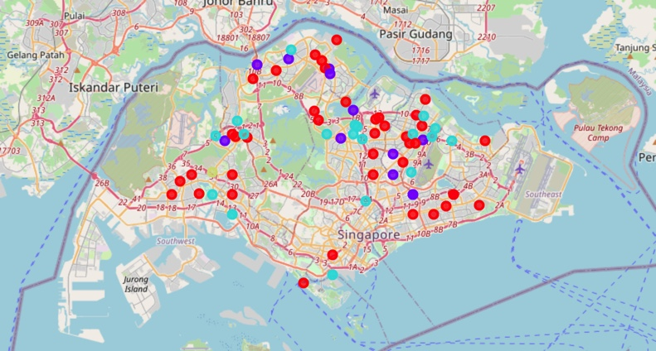
The Results
Cluster | Cluster Name | Cluster Description | Color
0 | ‘Bus Pooling’ Cluster | This cluster represents a neighborhood where one can commonly find Bus Stations and Swimming Pools as the most common venue found. There are restaurants found in the neighborhood, but they are not the most common venues. | Blue
1 | Not meaningful to assign a name | Not meaningful to analyze this cluster since there is only 1 neighborhood. | Black
2 | ‘Restaurant’ Cluster | This is the biggest cluster in the dataset, which indicates the most common venue pattern found in Singapore neighborhood. Typically, a neighborhood in this cluster has many restaurants followed by coffee shops and food court. | Red
3 | ‘Restaurant Lite’ Cluster | A neighborhood that has many restaurants but fewer than Cluster 2. It is mostly populated with substitutes like Food Courts and Coffee Shops. | Purple
👍
🙅‍♂️
🙅‍♂️
🙅‍♂️

Slide 7
Diving into Cluster 0
Neighborhood | 1st Most Common Venue | 2nd Most Common Venue | 3rd Most Common Venue
Kampong Cutforth | Golf Course | Pool | Restaurant
Kampong Sungai Tengah | Breakfast Spot | Light Rail Station | Supermarket
Tay Keng Loon Estate | Bus Station | Factory | Food Court
Kampong Beremban | Pet Store | Resort | Farm
Kampong Bukit Panjang | Bus Station | Supermarket | Karaoke Bar
Yio Chu Kang Estate | Restaurant | Hotel Pool | Pool
Yio Chu Kang | Bus Station | Restaurant | Pool
Kampong Amoy Quee | Pool | Food Court | Tennis Court
Singapore United Plantation | Pool | College Cafeteria | BBQ Joint
Saint Michael’s Estate | Café | Soccer Stadium | Coffee Shop
Teacher’s Housing Estate | Coffee Shop | Bus Station | Office
Saga | Hotel | Pier | Factory
Kampong Kopit | Hotel | Pier | Factory
Kampong Siren | Military Base | Pool | Bus Station
Kampong Sungai Blukar | Soccer Field | Gym | Beer Garden
Yew Tee | Bus Station | Building | Office
Punggol | High School | Bus Line | Chinese Restaurant
Kampong Pasir Ris | Warehouse Store | Furniture / Home Store | Moving Target
Kampong Java Teban | Ski Area | Planetarium | Playground
Kampong Sungai Pandan | Baseball Stadium | Steakhouse | Food & Drink Shop
West Coast Village | Baseball Stadium | Steakhouse | Food & Drink Shop
Legend:
 | Restaurant (including Hotel)
 | Restaurant Substitutes
 | Non-restaurant
👍
👍
👍
👍

Slide 8
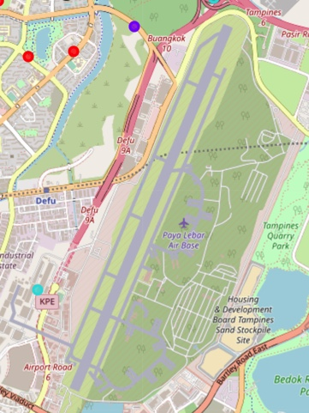
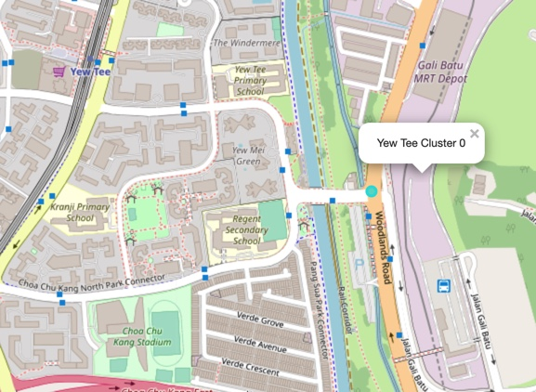
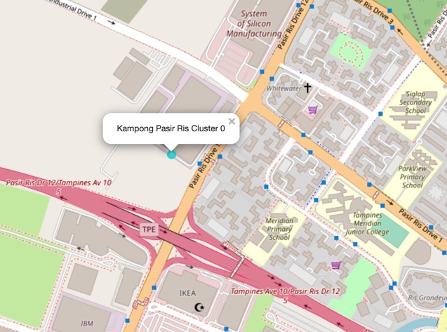
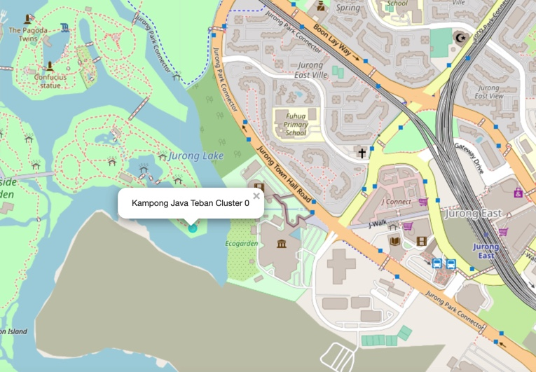
Our Recommendation
Kampong Siren | Yew Tee | Kampong Pasir Ris | Kampong Java Teban
Near Military Base Low expected customer traffic | Mostly residential places on the west Train depot on the east Potential high customer traffic | Mixture of industrial, commercial and residential buildings Near highway Potential very high customer traffic | Mostly recreational parks Some Residential areas on the north east Low expected customer traffic
👍

Slide 9





Conclusion
K-means Clustering determines that Cluster 0 has the least, restaurant competition in its neighborhood
Folium data visualization mapping indicates that ’Kampong Pasir Ris’ neighborhood has potentially the highest customer volume

Slide 10

Q&A
Thank you if there are no more questions!

